Slide 1
Case Study 1: Fashion Wave’s Retail Store Sales Analysis FY 2024-2025
Sai Jhansi Kongara
Student at Sharpener Tech

Slide 2
AIM
Analyze FashionWave’s retail sales performance, regarding Sales and Discounts, a mid-sized retail chain with 50 stores across India to provide necessary business recommendations to generate more Profit.
Business Objectives of this Case Study:
To improve weekend sales performance by 15% in the next quarter
To identify underperforming products and improve profitability
How discounts affect profit margins and recommend better discount strategies.
Tools Used:
Microsoft Power BI
Spreadsheet
ChatGPT

Slide 3

Business Analysis

Slide 4
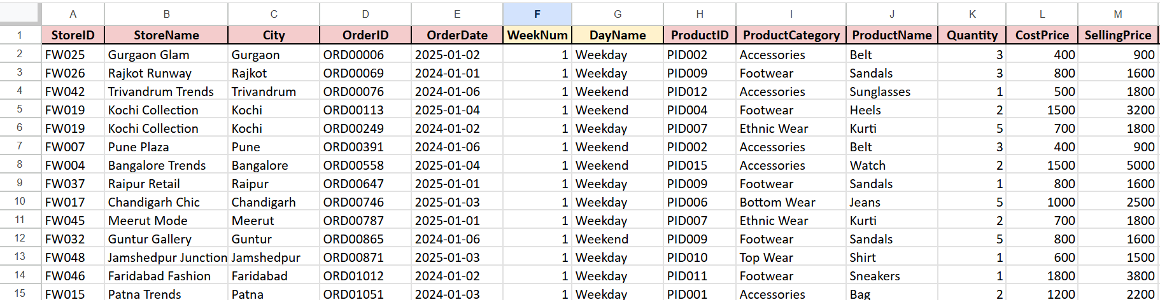
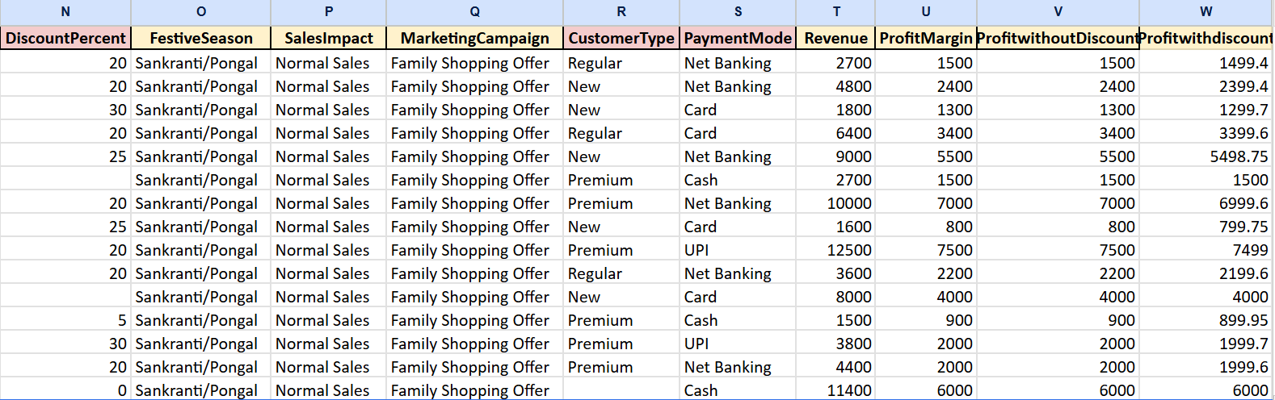
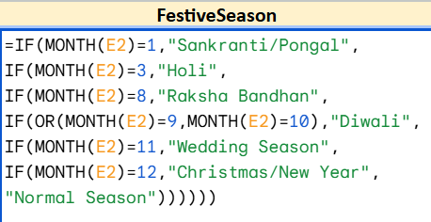
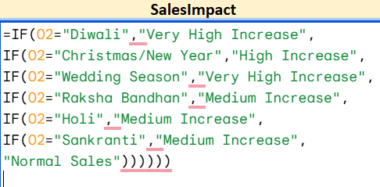
Dataset & EDA
5000 FashionWave, Retail 50 Store Sales Data Entries FY 2024-2025
DiscountPercent values are replaced with “0”.
CustomerType Blank entries replaced with “Unknown".
Revenue including Discount: =Quantity * (SellingPrice - (SellingPrice * DiscountPercent / 100))

Slide 5
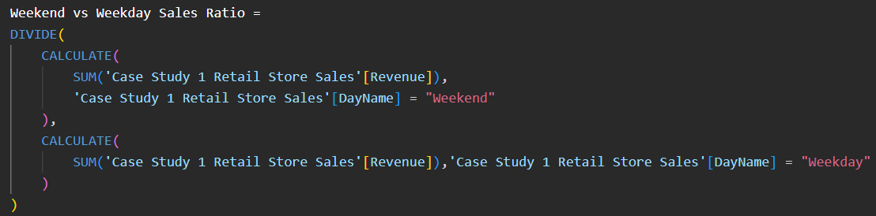
DAX Measures

Slide 6
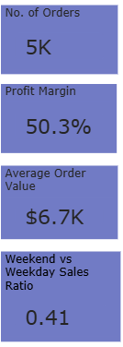
KPI Summary

Slide 7

Business Insights and Recommendations
in terms of Quick wins and long-term strategies

Slide 8
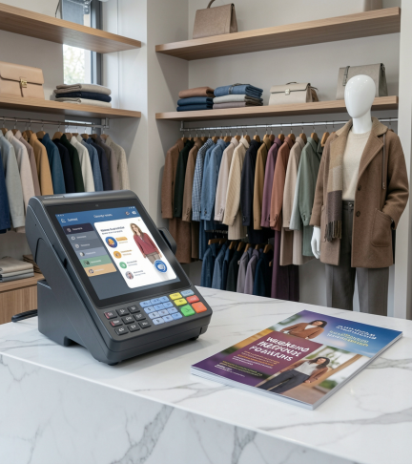
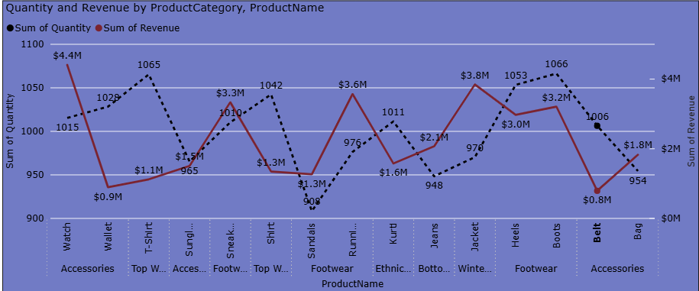
Revenue and Profit Trends
Watches and Jackets are the most revenue-generating categories, so they are the most profitable products.
Notes:
notes

Slide 9
Revenue and Profit Trends
Quick wins(0–3Months) Recommendations to actions:
Bundle low-performing products with top-selling products
Long-term strategies(3–12 Months):
Use customer purchase behavior for smart cross-selling
Notes:
notes

Slide 10
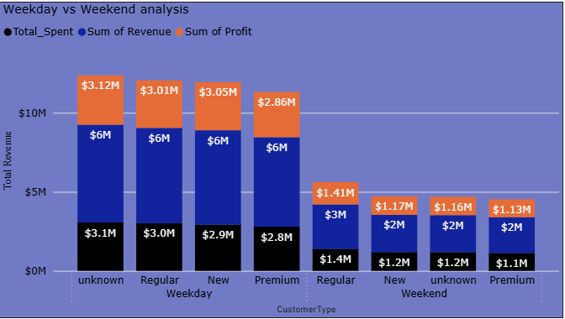
Weekend vs Weekday Analysis
Weekend sales contributed only 41% of weekday revenue from KPI. Ref: Slide no: 6

Slide 11
Weekend vs Weekday Analysis
Quick wins:
Introduce weekend flash sales and combo offers
Run personalized SMS, WhatsApp, and social media campaigns
Long-term strategies:
Implement AI-based personalized recommendation systems based on their Search History

Slide 12
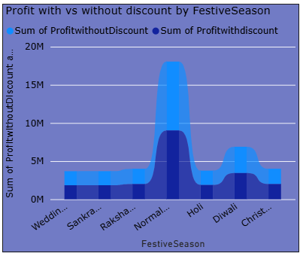
Discount Impact Analysis
A Ribbon Chart, to compare discount impact during festive season.

Slide 13
Discount Impact Analysis
Quick wins:
Limit discounts to 20–25%. increase short-term sales volume, excessive discounting may negatively impacts long-term profitability.
Apply targeted discounts only on slow-moving items
Long-term strategies:
Implement dynamic pricing strategies

Slide 14
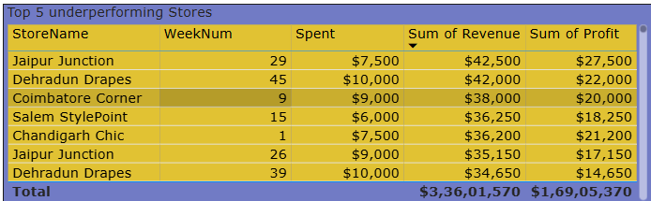
Top 5 Underperforming Stores
It is a table,Top 5 Underperforming Stores with regard to Revenue and Profit.

Slide 15
Top 5 Underperforming Stores
Quick wins:
Introduce clearance sales for slow-moving products
Long-term strategies:
Redesign or replace consistently low-margin products

Slide 16
Conclusions
Analyzed FashionWave’s retail sales data using Microsoft Power BI, Excel, and analytics techniques to identify insights related to sales trends, profitability, customer behavior, and discount impact.
The analysis showed that Watches and Jackets generated the highest revenue and strong profit margins,
By implementing strategies such as weekend promotions, personalized marketing, weekend sales, and discounts up to 20-25% and dynamic pricing, By these recommendations, FashionWave may increase weekend sales by 15% i.e, 11.2M 12.88M in the next quarter and improve overall business performance.

Slide 17

THANK YOU
Any Questions/Feedback?
Check out Working Model Here:
Case Study 1: Fashion Wave Retail Store Sales Analysis
Connect me at:
Sai Jhansi Kongara

